Slide 1

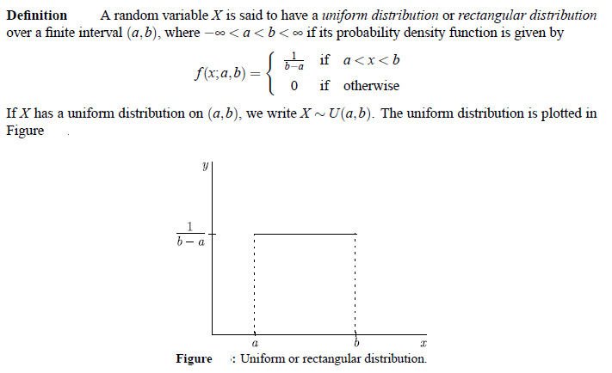

Slide 2
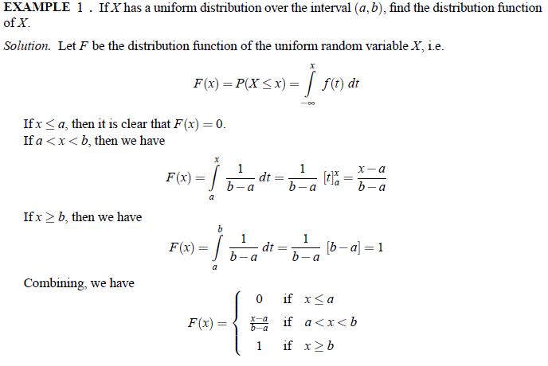
CUMULATIVE DISTRIBUTION FUNCTION

Slide 3
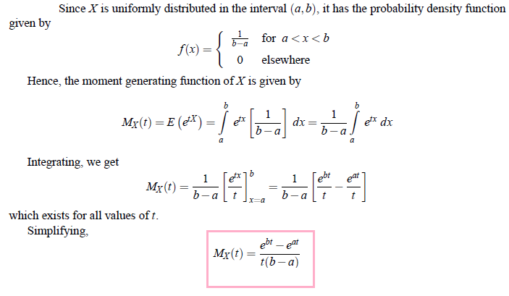
M.G.F, MEAN AND VARIANCE OF UNIFORM DISTRIBUTION

Slide 4
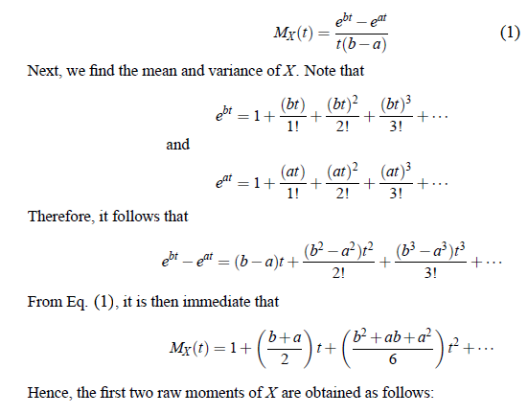

Slide 5
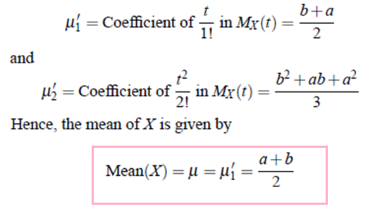
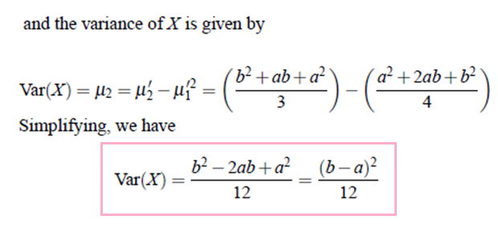

Slide 6
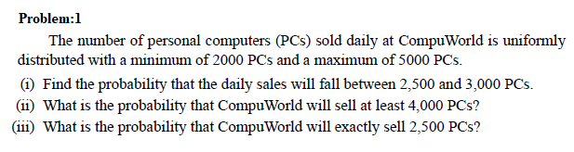
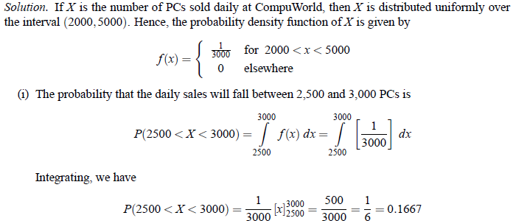

Slide 7
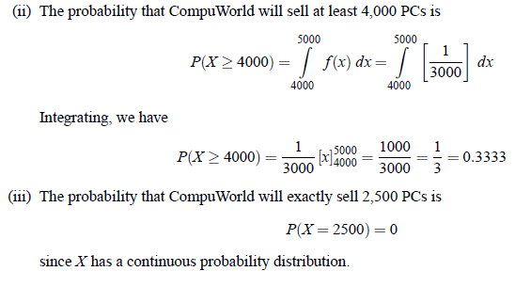

Slide 8
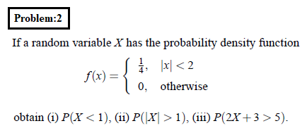
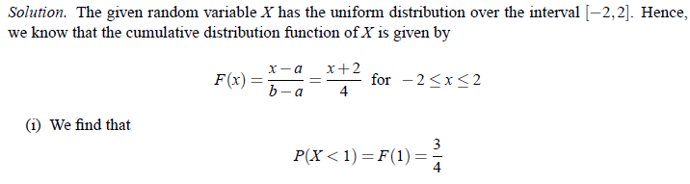

Slide 9
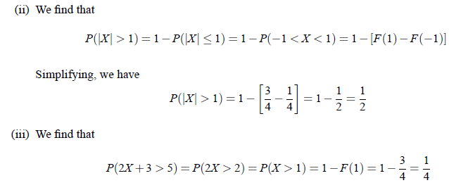

Slide 10

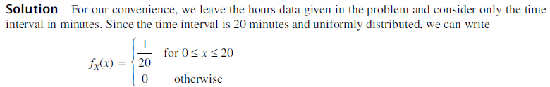
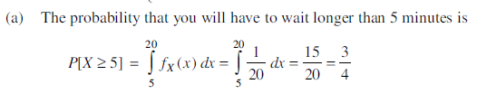
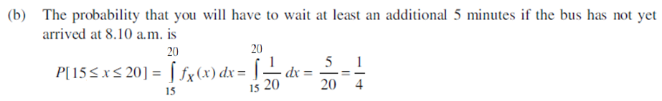
Problem:3

Slide 11
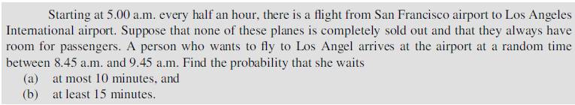
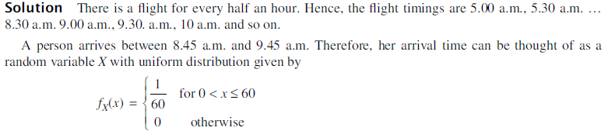
Problem:4

Slide 12
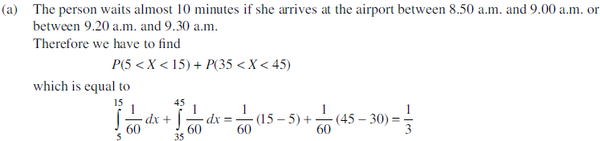
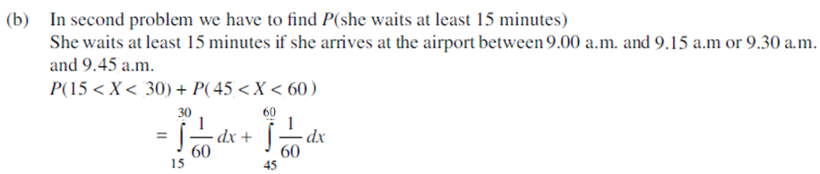
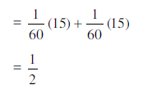

Slide 13

QUIZ
1. Buses arrive at a specified stop at 15-minutes interval starting at 7 a.m. That is, they arrive at 7, 7.15, 7.30, 7.45 and so on. If a passenger arrives at the stop at a random time that is uniformly distributed between 7 and 7.30 a.m. find the probability that he waits (a) less than 5 minutes for a bus, and (b) at least 12 minutes for a bus.
2. A point is chosen at random on the line segment [0, 10]. What is the probability that
the chosen point lies between 5 and 7
1.
2.

Slide 14
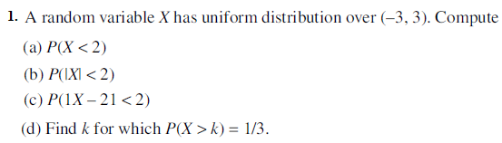
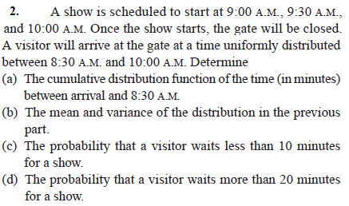
Problems for Practice

